Slide 1

Java Spring
Fanavaran Anisa
Iran Linux House
Linux & Open Source Training Center
www.anisa.co.ir

Slide 2

Session 1 – Introduction to Spring – Inversion of Control
Introduction
Spring history
Why Spring – Stackoverflow survey
Spring Pre-requirements
Tools
build first project based on Spring with Maven
Inversion of Control
factory design pattern
describe sample of dependencies
Spring Containers (ApplicationContext and BeanFactory)
Spring Bean
configuration metadata and the Spring application context with xml and annotations
@Configuration and @Bean annotations, @component and @ComponentScan
define bean and component scan with xml strategy
Bean Inheritance with Child and parent beans
types of bean injections
@Import: working with multiple configuration files and class, descibe @ImportResource
Complete exmple of DI with Shape Sample

Slide 3
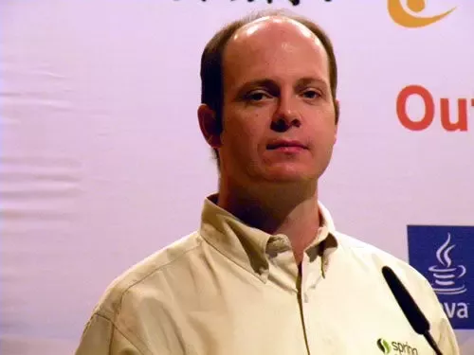
Spring History
Founder: Rod Johnson
First release: 2004
Spring Boot: 2014
Spring 5: 2017

Slide 4
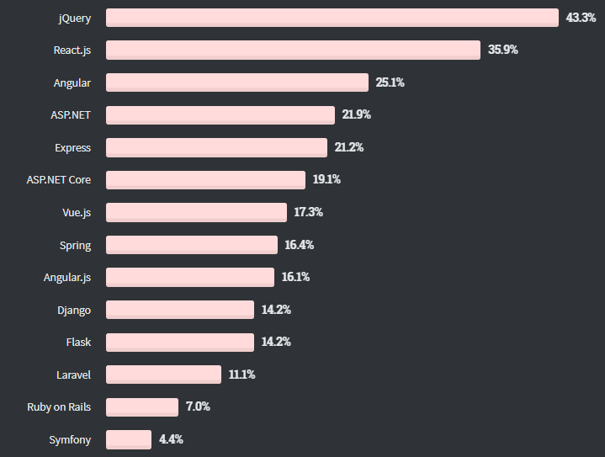
Why Spring StackOverFlow

Slide 5
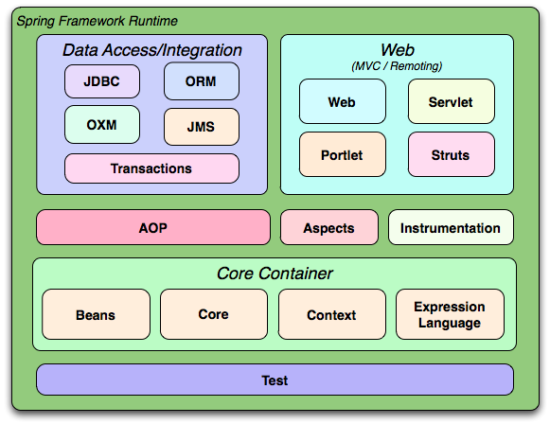
Spring Modules

Slide 6
Spring Pre-requirements
Java 8
HTML
Java Web Application
Spring fundamentals
Database

Slide 7
Required Tools
Java 1.8+
IntelliJ Idea

Slide 8
Spring Books & References
10 Books
Spring Doc References

Slide 9
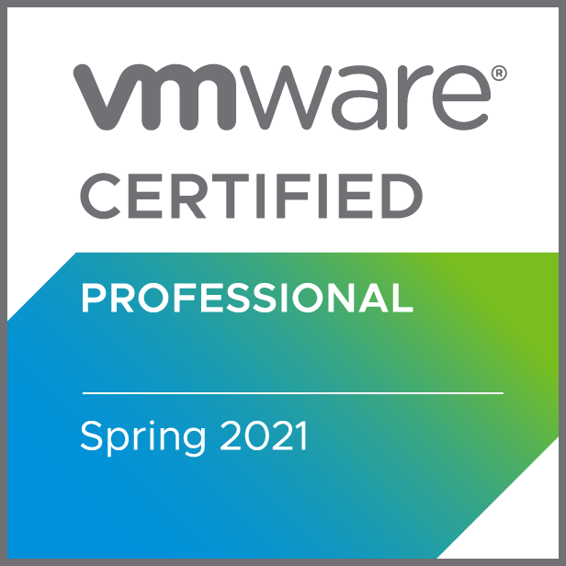
Spring Certificate
https://www.vmware.com/education-services/certification/vcp-spring.html
90 Minutes 50 Questions $250 USD
Consist of:
Container basics
Aspect Oriented Programming (AOP)
Data access and transactions
Spring model-view-controller (MVC)

Slide 10
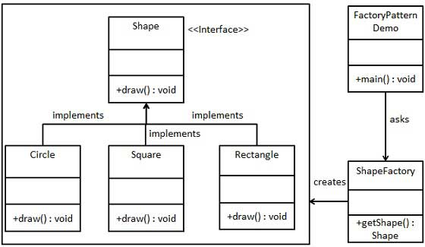
Factory Design Pattern

Slide 11
Inversion of Control
Software Design
Application Object not be responsible
IoC container
Constructor injection
Setter injection

Slide 12
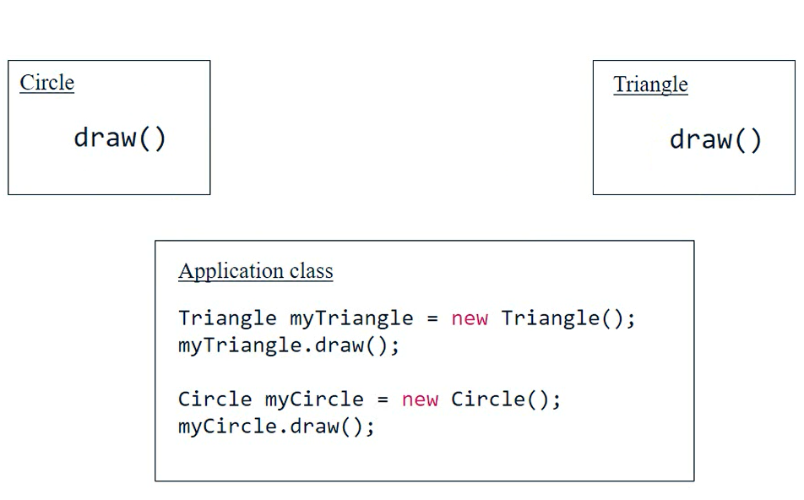
Inversion of Control

Slide 13
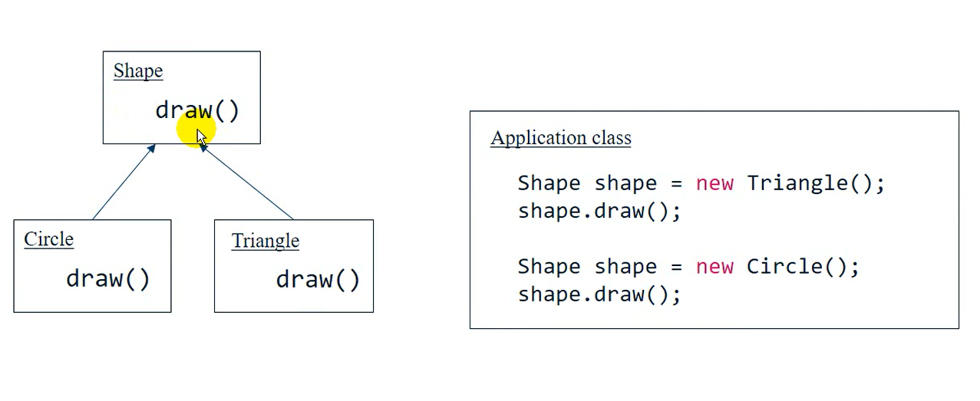
Inversion of Control
Using Polymorphism

Slide 14
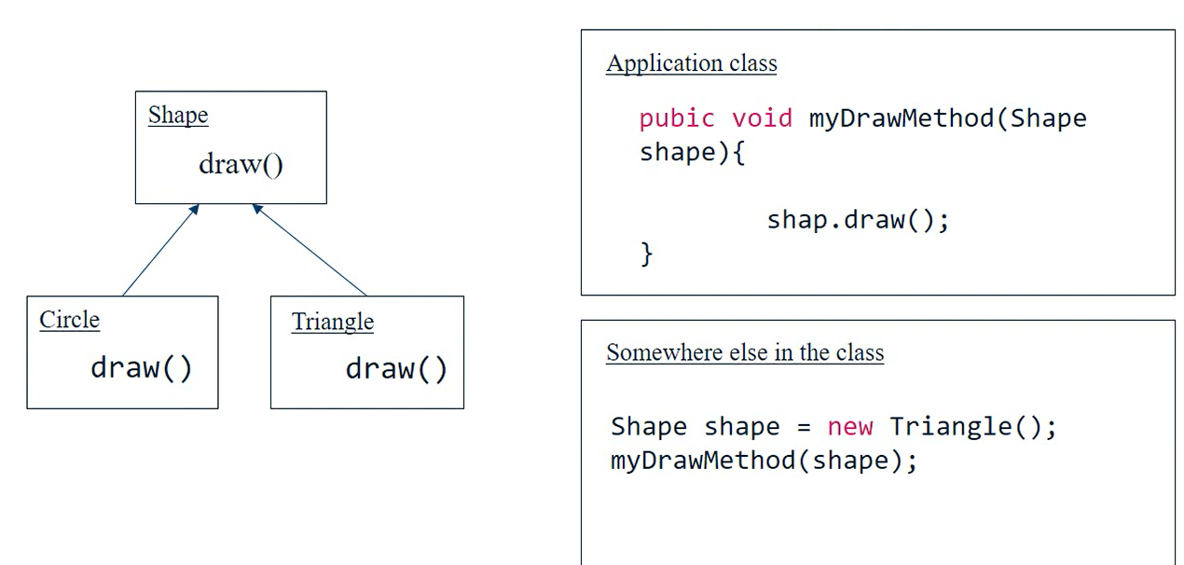
Inversion of Control
Method parameter

Slide 15
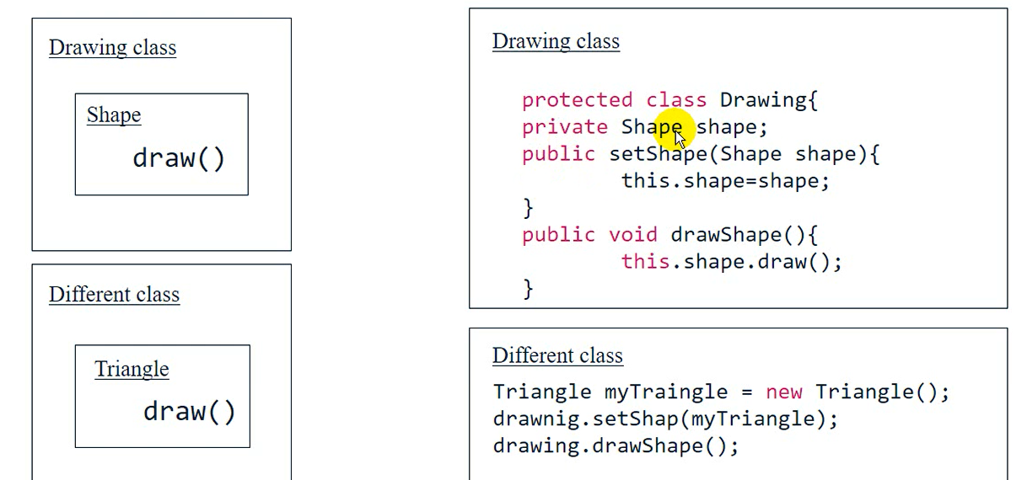
Inversion of Control
Class Member Variable

